Slide 1

Fast Food at a glance
2024 performance review and
the movement for 2025
Prepared by Hao Tran
Jan, 2026

Slide 2

Analysis contents
A. Segment performance in 2024 Executive summary Overall performance Contributions analysis: Orders drives Fees drives AOV drives
B. Promotions cutting plan for 2025 Proposed plan Underlying evaluation explains C. Recommendations – what to do next?
3
12
5
14
7
8
13
15

Slide 3
In 2024 …
The Fast Food segment achieved strong growth, but is increasingly reliant on a small group of leading brands, exposing the business to concentration risk if performance from these players slows down.
Growth is primarily volume-driven rather than value-driven, indicating that demand expansion is driven by higher order frequency rather than stronger consumer spending (shift toward mass-market, lower-priced brands)
Expansion is fueled more by store network growth than improvements in outlet productivity, suggesting that underlying operational efficiency has not significantly improved.
Promotions are the key driver of order growth, but increasing reliance on promotion volume rather than effectiveness raises concerns around long-term sustainability and unit economics.

Slide 4
In 2024 …
Leading brands (E, D, X) contribute the majority of orders and GMV growth, but their performance is largely driven by aggressive store expansion and promotion intensity, with limited improvement in outlet-level productivity, requiring close monitoring to ensure growth remains efficient.
Emerging brand (Y) demonstrates strong growth with relatively stable basket value, indicating healthier fundamentals; however, its rapid increase in promotion intensity suggests a growing dependency that may pose risks to sustainable performance.
Overall, the segment presents an opportunity to shift toward more efficient and sustainable growth, by reducing over-reliance on promotions while strengthening underlying demand quality and operational efficiency.

Slide 5
Aligning with the positive trend of Vietnam market, our Fast Food segment demonstrated an overall strong performance and a noticable skewness to top performers (E, D, F, X) in 2024
Vietnamese Fast Food market:
AAA Fast Food segment:
GMV by brand, mil USD
60.6
million USD of GMV
+24% YoY
YoY | +18% | +84% | -9% | +35% | +5% | +112 | +10% | -3% | -19%
**
GMV growth, mil USD
Overall, GMV exhibited an upward trend throughout 2024. Despite a temporary mid-year decline, likely due to seasonal effects consistent with 2023 patterns, the momentum recovered strongly at the end of the year.
953 mil USD*
+7% YoY
2023
2024
(*) Source: Euromonitor International
(**) Please note: this order of brands will be leveraged during this report, with the priority for the brands with highest GMV shares

Slide 6
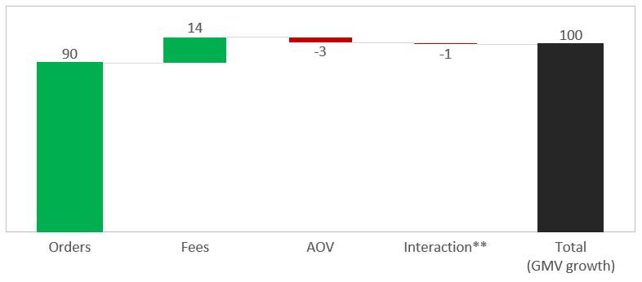
GMV growth is almost entirely volume-driven, with declining order value partially offsetting gains
Total GMV, mil USD
Contributions* to GMV growth, %
+24%
GMV growth is primarily volume-driven, with Orders contributing a substantial 90% to the total increase. While Fees added a supportive 14%, a 3% decline in AOV acted as a minor drag, suggesting a shift toward more frequent but lower-value transactions
(*) Please refer to Appendix
(**) Combined effect of volume & value (orders & AOV)

Slide 7
The overall orders is growing and heavily dictated by the performance of key players. This suggests the dependency of sources of growth to the top-tier brands, but also the lack of diversity across the porfollio.
Orders drives
Total Orders, mil
Orders by brand, thousand
+25%
+15%
+90%
+35%
Other
brands
x4
E, D, F, X
+101%
The order landscape is highly concentrated, with the top 4 brands (E, D, F, X) accounting for 80% of total order share. Performance across the top tier is largely positive, led by an exceptional 90% surge in Brand D's orders. Also, brand Y is the rising star with the 2x in Orders generating

Slide 8
The volume surge is not just a result of physical expansion but also reflects a genuine increase in consumer demand and store productivity
Orders drives
Number of Outlets
Monthly Orders per Outlet
+10%
+10%
The growth in orders is driven by a dual-engine effect: a expansion in outlet footprint coupled with a rise in orders per outlet.

Slide 9
Orders growth among leading brands is primarily driven by outlet expansion
Orders drives
Number of Outlets by brand
Orders per Outlet by brand
+14%
+14%
+23%
Brands E, D, and X have seen an impressive expansion in their outlet footprint, while order productivity per location has remained remarkably consistent across brands

Slide 10
Our growth in Orders is driven by expanding our reach to more customers rather than relying on deeper, unsustainable discounts
Orders drives
Total promo, mil USD
Promo per Order, USD
+23%
~
The 23% increase in total Promo spend acts as the primary fuel for order growth, while Promo per Order remains stable over years

Slide 11
Promotional investment has effectively driven orders for leading brands while maintaining a stable cost-per-order. This demonstrates a highly efficient scaling model without eroding unit margins. However, Brand Y is high reliance on subsidies with diminishing returns on volume
Orders drives
Total Promo by brand, mil USD
Promo per Order by brand, USD
+100%
+15%
+76%
+305%
+28%
While promotional spending has increased for leading brands (E, D, X), their Promo per Order remains stable. In contrast, brand Y exhibit high promo consumption with disproportionately low order volumes, signaling a need for closer strategic oversight

Slide 12
Fees’ source of growth is from Orders scaling. This also suggests the current monetization model demonstrates high resilience and steady performance.
Fees drives
Total fees, mil USD
Fees per Order, USD
+ 26%
~
Fees increases in line with Orders, leads to the stability in the Fees per Order ratio from 2023 to 2024

Slide 13
Fees increases are driven by rising order volumes across the portfolio. Also, our monetization model’s effectiveness is consistent for all brands
Fees drives
Fees by brand, mil USD
Fees per Order by brand, USD
The Fees per order ratio is kept stable across brands

Slide 14
The market has historically been driven by low-cost brands in terms of GMV. In 2024, the accelerated growth within this segment further amplified this trend, effectively diluting the overall AOV and reflecting a stronger shift toward mass-market consumption
AOV drives
Total AOV and by brand, USD
GMV by brand, mil USD
+18%
+84%
+35%
+112%
Although E, D, F, X are the top performers in GMV (and Orders), they also the lowest AOV. This indicates that the total GMV is being 'inflated' by low-value brands
Growth is primarily driven by low-AOV brands such as E, X, and D. This downward shift in the brand mix has hindered the overall AOV expansion throughout 2024.

Slide 15
Proposed plan for cutting promotions spending in 2025:
Brand | % to cut | Budget saved (1000 USD)
C | -100% | 75
D | -15% | 133
F | -10% | 97
Z | -16% | 60
G | - 58% | 30
X | -4% | 27
Y | -3% | 9
E | 0% | 0
B | 0% | 0
Total | 10% of total AAA promo | 431
This plan will help:
Enable a more holistic and data-driven promotion strategy
Combining promo efficiency, dependency, and elasticity provides a more complete view of how promotions actually drive demand. This helps the marketing and demand planning teams move from intuition-based decisions to a structured, data-driven approach.
Balance growth objectives with cost efficiency and demand stability
Each metric captures a different aspect of promotion impact. Together, they ensure that promotion cuts are optimized not only for cost savings, but also for maintaining stable demand and avoiding unintended volume drops.
Ensure promotion investment is aligned with both performance and strategic priorities
By incorporating strategic importance alongside quantitative metrics, the approach allows the business to differentiate between purely performance-driven decisions and those that support long-term strategies, resulting in a more balanced and sustainable allocation of promotion budget.

Slide 16
A robust promotion optimization strategy should be grounded in the following criteria, which constitute a three-layer evaluation framework
Efficiency | The efficiency in GMV generate on promotions
Dependency | The dependency of brand to promo for generating GMV
Elasticity | The intensity in GMV decrease when cutting an amount of promo
Strategic importance | The importance of a brand to the business strategies
+ Strategic importance
3rd layer
+ Elasticity
2nd layer
Efficiency & Dependency
1st layer

Slide 17
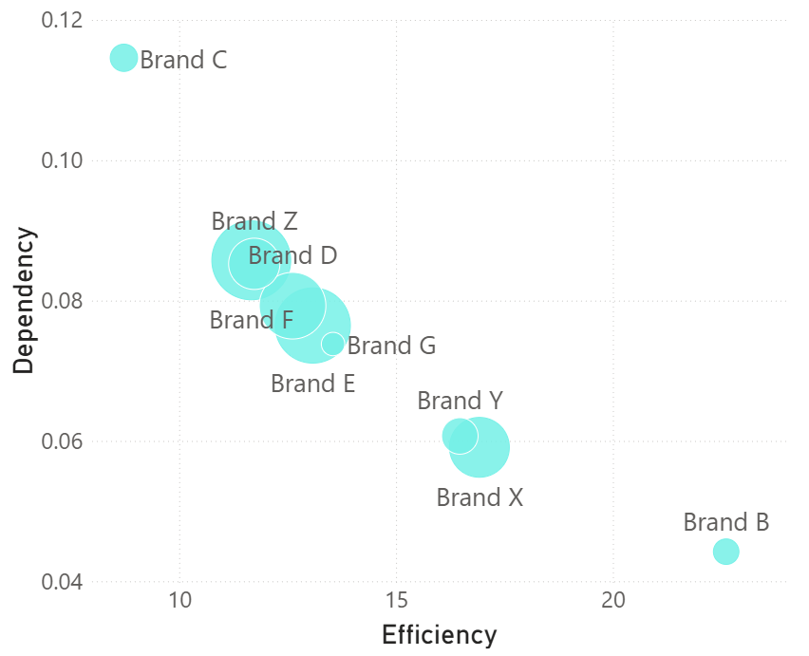
Based on the initial evaluation layer, Brands C, Z, D, and F emerge as the primary candidates for promotional reductions
Dependency vs. Efficiency sizing by promo spending
Four-group brand segmentation and action plans:
Growth lever
Inefficient
 | Actions | Brand
Inefficient | Potential to cut | C, Z, D, F
Growth lever | Optimize | -
Neutral | Selective | E, G
Stars | Protect | Y, X, B
Neutral
Stars

Slide 18
The second layer integrates Elasticity metrics into the performance score to prioritize brands for substantial promo scaling back
Ranking score*
Cutting intensity
A consolidated assessment of Efficiency, Dependency, and Elasticity reveals the performance ranking of our brands. The ranking score evaluates the performance of each brand based on 3 factors: Efficiency, Dependency and Elasticity. The lower the score is, the more that brand is potential for promo reduction
(*) Please refer to Appendix

Slide 19
The final layer filters cuts through a strategic lens. Budget reductions for Brands E, D, X, Y have been adjusted downward to protect their contribution to overall GMV growth.
GMV by brand, mil USD
+18%
+84%
+35%
+112%
Brands E, D, X and Y play a the critical role in GMV expansion

Slide 20
In 2025 - What to do next?
For Business Stakeholders: Rebalance growth from volume-driven to value-driven by reducing over-reliance on promotions and improving overall promotion efficiency. Reallocate promotion budget toward high-performing and scalable brands, while selectively reducing investment in low-efficiency, high-dependency brands. Incorporate strategic importance in decision-making, protecting key partners and traffic-driving brands to sustain long-term growth and competitive positioning.
For Marketing Team: Shift from mass promotions to targeted, performance-based campaigns, focusing on improving promotion quality rather than increasing volume. Reduce blanket discounting that drives orders but dilutes AOV, and explore tactics such as bundling, upselling, or personalized offers. Continuously monitor promotion efficiency and dependency at brand level, and adjust campaign intensity dynamically based on performance.

Slide 21
In 2025 - What to do next?
For Demand Planning Team: Incorporate promotion elasticity into demand forecasting to better anticipate the impact of promotion changes on order volume. Plan promotion cuts in a controlled and phased manner, especially for high-dependency brands, to avoid sudden demand shocks. Collaborate with marketing to test and validate promotion strategies (e.g., A/B testing), ensuring that demand remains stable while improving efficiency.

Slide 22

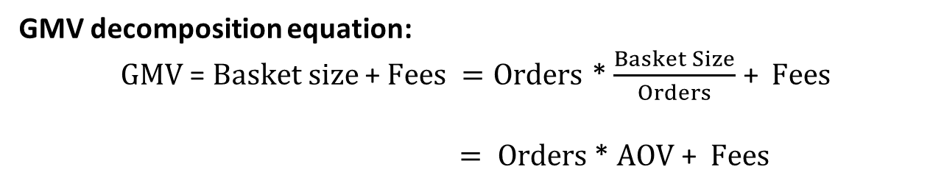
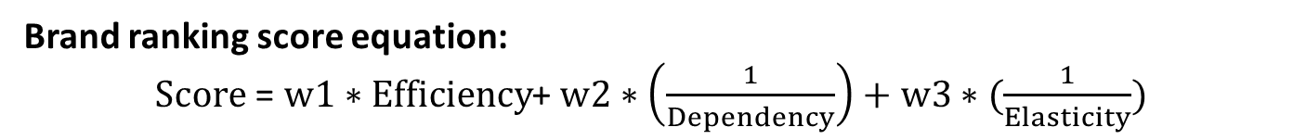
Appendix
GMV decomposition equation:
$GMV$ = $Basket size$ + $Fees =Orders$ * $\frac{Basket Size}{Orders}$ + $Fees$
$= Orders$ * $AOV$+ $Fees$
Brand ranking score equation:
$Score$ = $w1∗Efficiency$+ $w2∗\left(\frac{1}{Dependency}\right)+w3∗(\frac{1}{Elasticity})$
Brand ranking score calculations:

Slide 23
Thank you
Contact me at myhao14159@gmail.com for more discussions!

